Slide 1
Cef 440: internet programming (j2ee) and mobile programming
PROJECT TITLE:
DESIGN AND IMPLEMENTATION OF A MARKET
MANAGEMENT SYSTEM
TASK 3: DESIGN PHASE

Slide 2
Group members
GAMUAH PADJINOU RYANE JOY FE20A044
NDALEGH NOELA LUM MBAH FE20A070
FORMASIT CHIJOH FOKUNANG FE20A041
RACHEAL NKONGHO TAFONGOH FE20A100
MOSONGO ADINA SAKWE NANGERI FE20A066

Slide 3

Table of contents
DESIGN OF UML DIAGRAM
USE CASE DIAGRAM
CLASS DIAGRAM
ACTIVITY DIAGRAM
SEQUENCE DIAGRAM
ADD PRODUCT
SEARCH PRODUCT
SHOP REGISTRATION
BUYERS INTERACTION
PRODUCT ADVERTISEMENT
DATA FLOW DIAGRAM

Slide 4

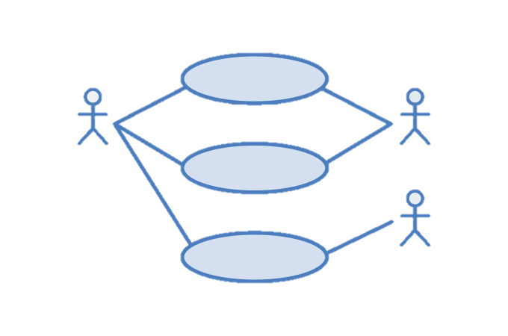


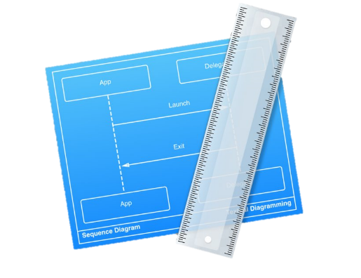
DESIGN OF Uml diagrams
The UML diagram is aimed at visually representing a system along with its main actors, roles, actions, classes, in order to better understand, alter, maintain, or document information about the system.
They provide a template to understand and follow, from which the product proper can be developed.
For the system at hand, we have represented the following UML diagrams:
Use Case Diagram
Class Diagram
Activity Diagram
Sequence Diagram
Data Flow Diagram

Slide 5
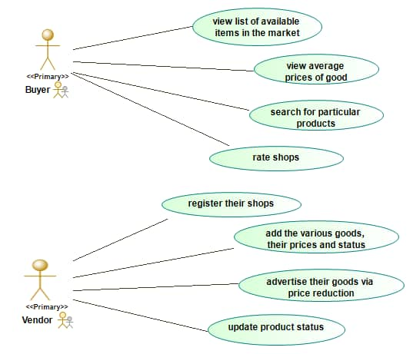
Use case diagram
It shows the various use cases and the different users the system has, showing their interactions. It presents a graphical depiction of users’ possible interactions with the system.

Slide 6
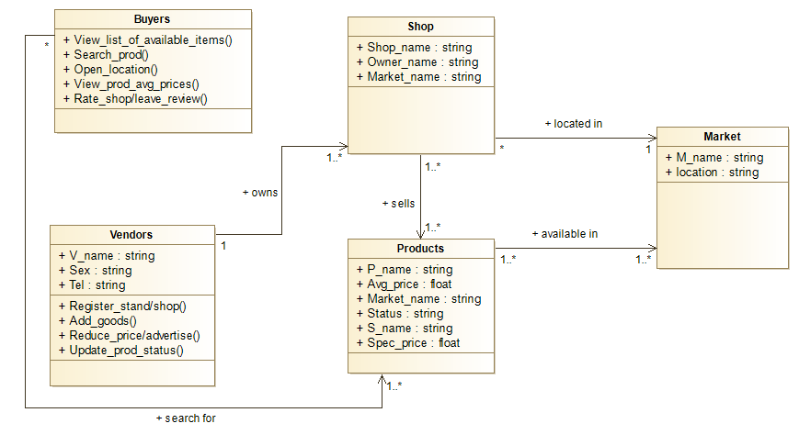
Class diagram
It is the blueprint of the system which models the objects that make up the system, displaying the relationships between them, describing what the objects do and the services they provide.

Slide 7
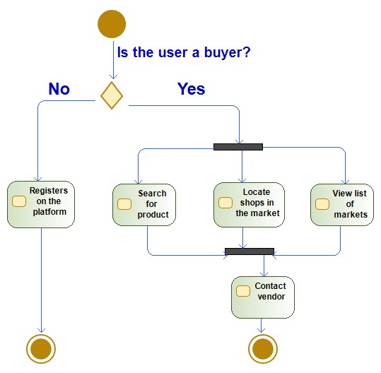
Activity diagram
It visually presents a series of actions or flow of control (from one activity to another) in the system, describing the steps in the use case diagram and also depicts the workflow from start point to finish point.

Slide 8
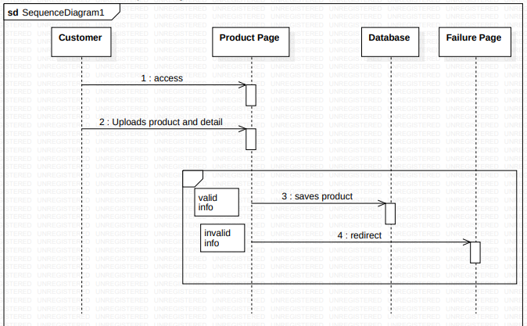
sequence diagram
These diagrams describe how - and in what order – a group of objects work together, showing the process interactions arranged in time sequence. They are important in understanding the system requirements or document a process.
Add Product

Slide 9
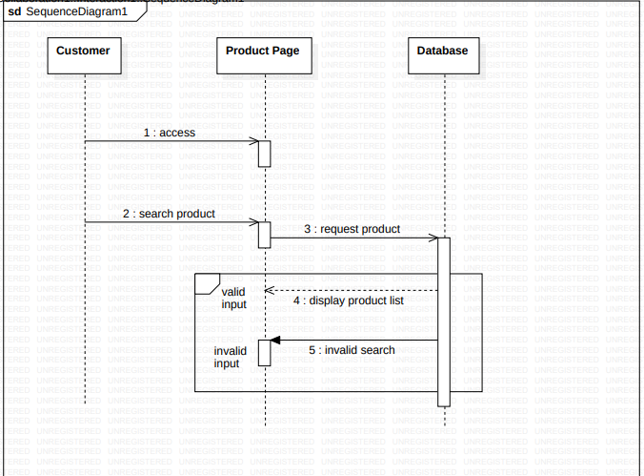
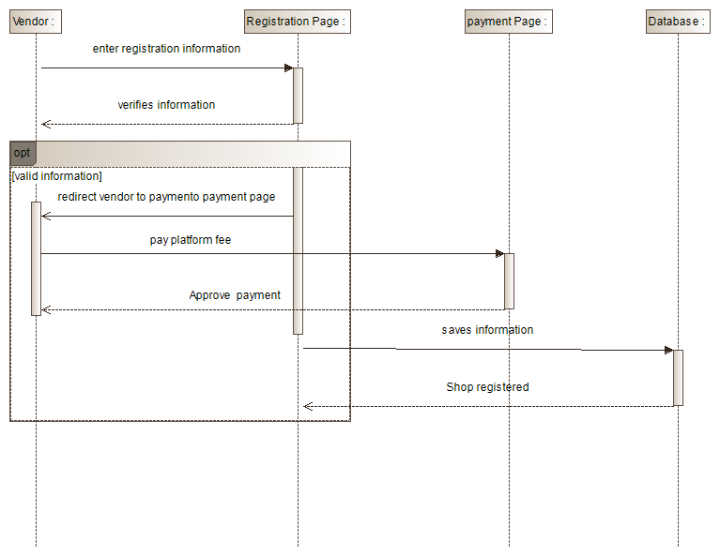
sequence diagram
Search Product
Shop Registration

Slide 10
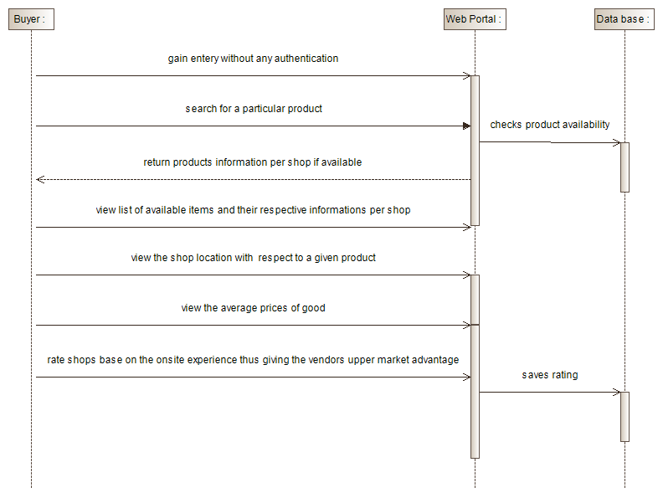
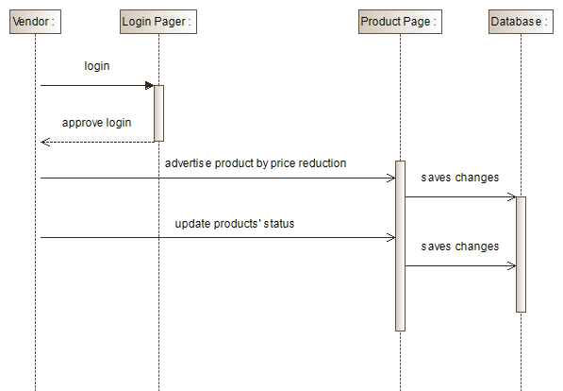
sequence diagram
Buyers Interaction
Product Advertisement

Slide 11
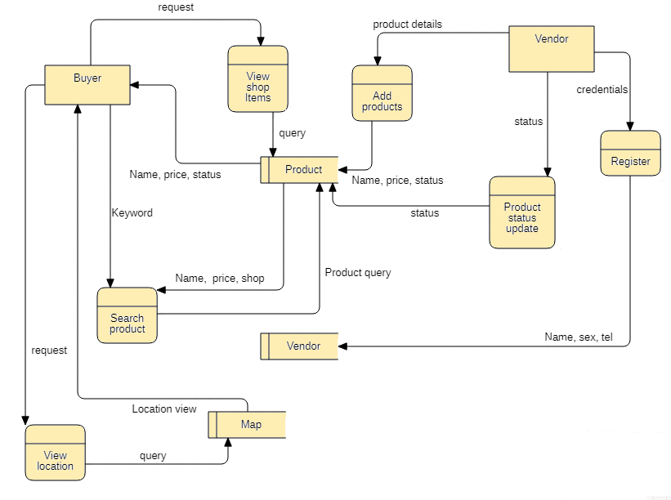
Data flow diagram
It maps out the flow of information for any process or system, providing information about the outputs and inputs of each entity and the process itself, and also including data stores and the sub-processes the data moves through.

Slide 12

THE END !

